Slide 1

Girls Who Code Teacher Training
Robotics
‹#›

Slide 2

Interaction Meter
Interaction mode: You’ll be observing, participating, and leading at different times during this session. If you are ever confused what your role or task is, ask a neighbor or raise your hand.
I DO | WE DO | YOU DO

Slide 3
HOOK
Differentiation
30 seconds:
Collect every robot you can think of. You can write them down, type them, draw them, copy/paste images, whatever works for you.

Slide 4
HOOK
Questions
What do each of these things have in common?
What is a robot?
Notes:
3 min to find a partner to talk.
1 min to share out/return to seats
1 min - Analogies and connections to real life are great ways to explain these coding concepts to students. We are going to leverage this during this session.

Slide 5
Teaching Move
Differentiation
Adapting a lesson or activity to meet the specific needs of your students
Differentiation
Remember: when we use it, you’ll see this icon on the slide!

Slide 6
OBJECTIVES
By the end of this session, GTWBAT:
Explain how and where robotics fits in the scope of Summer Immersion Program
Identify and explain the use of these components:
Arduino
Board of Education shield
Breadboard
LED
Resistor
Jumper Wire
Create a circuit on a breadboard
Write a program for your Arduino
Notes:
Call on a teacher to read this
GTWBAT = Great teachers will be able to
Say:
What this is, what this isn’t:
It is going to give you some time to refresh introductory vocabulary.
It isn’t going to teach you everything about object oriented programming.
It is going to connect you to resources where you can refresh your syntactical skills
It isn’t going to teach you all of the dots, commas and colons you need to create your own class.

Slide 7
CONTENT IN CONTEXT
Unit 1: Fundamentals
Unit 2: Applications
Unit 3: Advanced Topics
Unit 4:
Final Projects
When?: Week 3
Why?: Having a physical object is more relatable and fun for many students.
Related Project?: Escape Bot
Notes:
< 1 min
Pause to give them time to read.
Say: The content we are going to learn and experiment with during this session falls near the end of SIP, after girls have learned all of the rest of their content.

Slide 8


CURRICULUM FUNNEL
Learner Profile
and
Essential Questions
Big Picture
Unit Plans
Lesson Plans
Your
Decisions
Small Moments
Notes:
< 1 min
Say: We are going to be operating at the lesson/decision level for the next 90 minutes, but we’ll pull out and look bigger picture at the end.

Slide 9
Agenda
Hook - 5 Min
Objectives, content, agenda - 5 min
Introduction to circuit components - 20 minutes
Create a circuit - 15 minutes
Program a circuit - 15 minutes
Servos & dance - 15 minutes
Closing - 5 minutes

Slide 10
Day 1

Slide 11
Circuit Component Scavenger Hunt
Differentiation
Get up (bring your computers with you; we’re moving)
Organize yourselves into 3 groups:
I feel very comfortable around robotics and circuitry (left)
I think I will recognize some words (middle)
I know nothing about robotics / circuitry (right)
In each group, count from 1 to 12. Sit at that table

Slide 12
Circuit Component Scavenger Hunt
In groups with the rest of your group - 10 min:
You have a bunch of parts on your table
You also have a worksheet with the names of those things, and a column for what they do and how they do it. Make a copy.
In groups, use the internet to fill out the table
As a whole group, we’ll talk about other group’s answers.

Slide 13
Circuit Component Scavenger Hunt
Draw and explain
Arduino
Board of Education Shield
Breadboard
Resistor
Jumper wire
LED

Slide 14
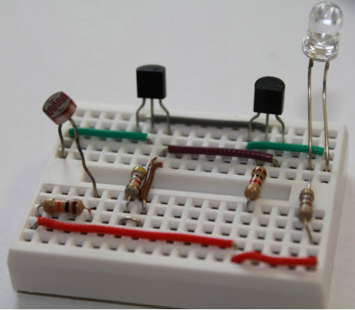

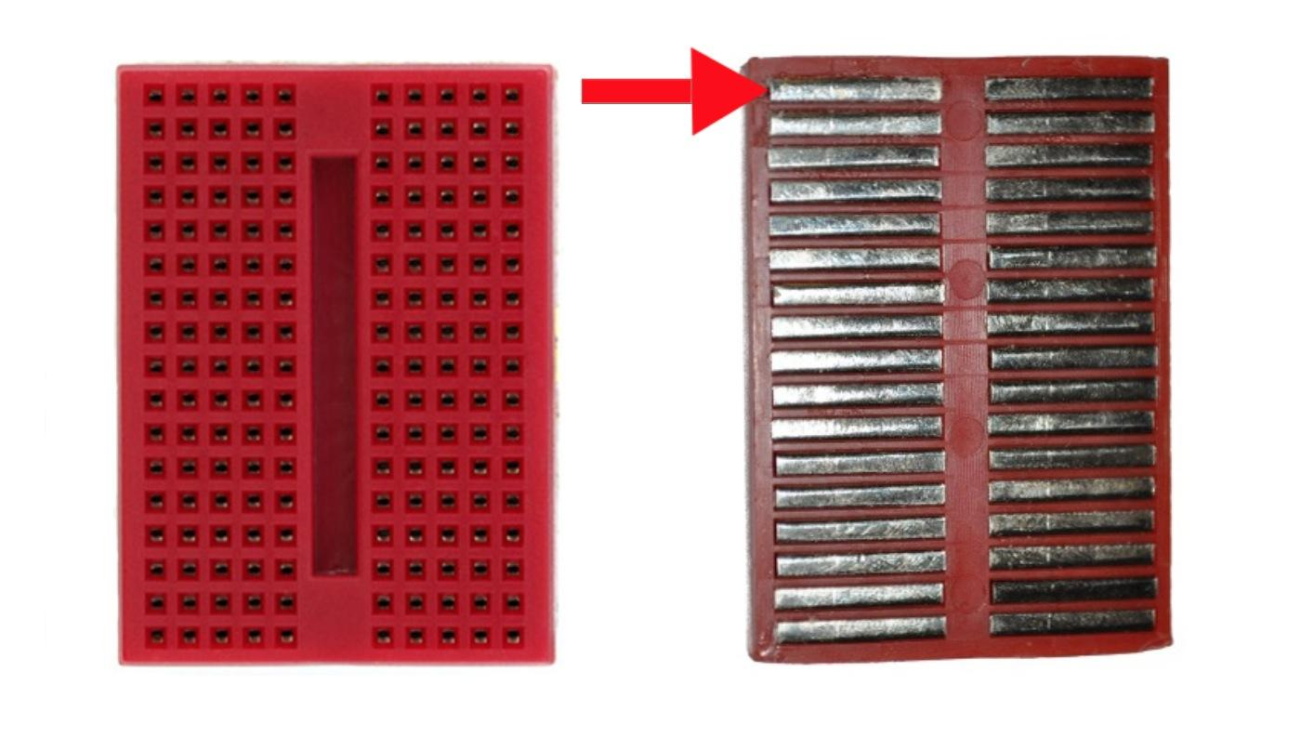
What is a breadboard?
Notes:
A Breadboard is a tool used to prototype electronics.
Each horizontal line of five pins is connected

Slide 15
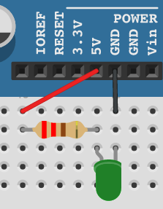
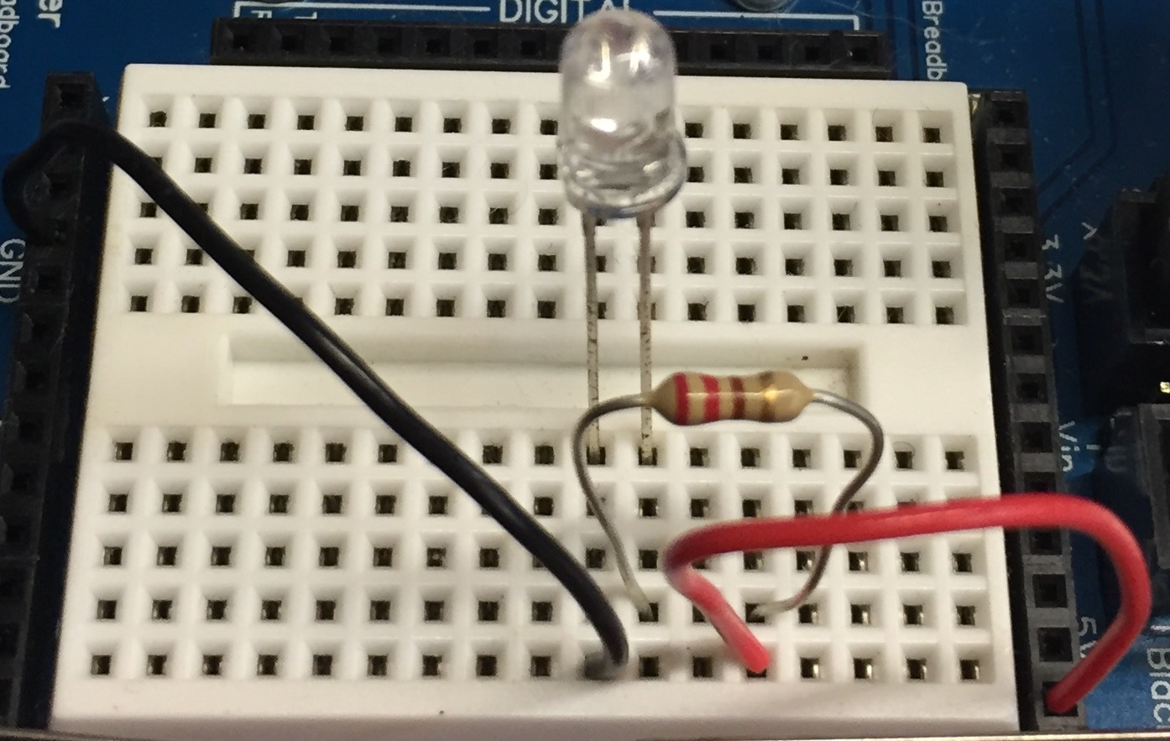
Create a Circuit!
In groups with the rest of your table - 10 min:
Use the breadboard, jumper wires, resistor and LEDs to create a circuit that will turn on an LED

Slide 16
Day 2

Slide 17
Mystery program!
Differentiation
Building background knowledge protocol
In groups with the rest of your table - 10 min:
Check out the program at this link
As a group, work out the following questions:
How do you get the program to run?
What do you think this code does?
Did anybody get the program to do something? What did you get it to do? How did you do it?
What do “setup()” and “loop()” do?
If you’d like more information check out this article

Slide 18
void setup() {
// initialize digital pin 13 as an output.
pinMode(13, OUTPUT);
}
void loop() {
digitalWrite(13, HIGH);
delay(1000);
digitalWrite(13, LOW);
delay(1000); }

Slide 19
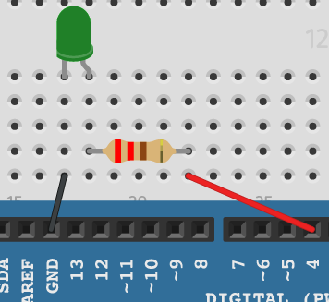
Mystery program! - pins

Slide 20
Mystery program! - pins
pinMode(pin , INPUT/OUTPUT)
digitalWrite(pin, HIGH/LOW)

Slide 21
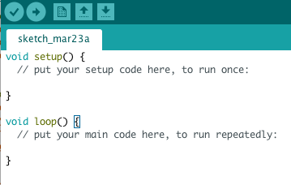
Mystery program! - setup and loop

Slide 22

Mystery program! - delay
delay(time)

Slide 23
Program your own LED
5 minutes
Make an LED blink using an Arduino program
Milestone:
Make it blink so quickly it looks like it is just dim

Slide 24
Day 3

Slide 25
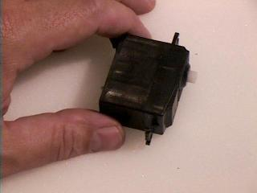
Servos
What is a servo?
What is a servo? What does it do?
Servos rotate! More if you give them more power.

Slide 26
Servos - Programming
Clockwise:
servo.writeMicroseconds(1300)
Counterclockwise:
servo.writeMicroseconds(1700)
Not moving:
servo.writeMicroseconds(1500)

Slide 27
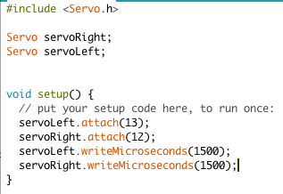
Servos
Include Servo Library
Declare Servo type variables for each servo
Setup pins 12 and 13 as servo pins
Set position to not moving

Slide 28
Dance robot!
In groups with the rest of your table - 10 min:
Make the robot move forward.
Make the robot move backward
Make the robot spin left
Choreograph and program a dance for your robot

Slide 29
REFLECTION: CURRICULUM FUNNEL
Learner Profile
and
Essential Questions
Unit Plans
Lesson Plans
Your
Decisions
Notes:
< 1 min
Say: We are going to be operating at the lesson/decision level for the next 90 minutes, but we’ll pull out and look bigger picture at the end.

Slide 30
REFLECTION: BIG PICTURE
Discuss with a partner:
How might learning about Robotics inform or change a student’s answer to one of the Essential Questions below?
In what ways can CS impact your community and society at large?
How can we each ensure the learning of others within our group or team?
How and why do we use computer science to solve problems?
How might this project help girls build the qualities in the Learner Profile?
How did the teaching move we highlighted this session improve student learning?
Notes:
< 1 min
Say: We are going to be operating at the lesson/decision level for the next 90 minutes, but we’ll pull out and look bigger picture at the end.

Slide 31
CLOSING: HOW DID WE DO?
By the end of this session, GTWBAT:
Explain how and where robotics fits in the scope of Summer Immersion Program
Identify and explain the use of these components:
Arduino
Board of Education shield
Breadboard
LED
Resistor
Jumper Wire
Create a circuit on a breadboard
Use Arduino C to write a program that responds to input
Notes:
Call on a teacher to read this
GTWBAT = Great teachers will be able to
Say:
What this is, what this isn’t:
It is going to give you some time to refresh introductory vocabulary.
It isn’t going to teach you everything about object oriented programming.
It is going to connect you to resources where you can refresh your syntactical skills
It isn’t going to teach you all of the dots, commas and colons you need to create your own class.

Slide 32
Training Progress
Friday | Saturday | Sunday
Classroom Mgmt | OOP | Final Projects
How to Use Curriculum | Robotics | SIP Simulation
Escalation Process | Diversity and Inclusion
Python |  | Training to Week 0
Django

Slide 33
CLOSING: THANK YOU!
Notes:
Call on a teacher to read this
GTWBAT = Great teachers will be able to
Say:
What this is, what this isn’t:
It is going to give you some time to refresh introductory vocabulary.
It isn’t going to teach you everything about object oriented programming.
It is going to connect you to resources where you can refresh your syntactical skills
It isn’t going to teach you all of the dots, commas and colons you need to create your own class.

Slide 34
Day 4

Slide 35
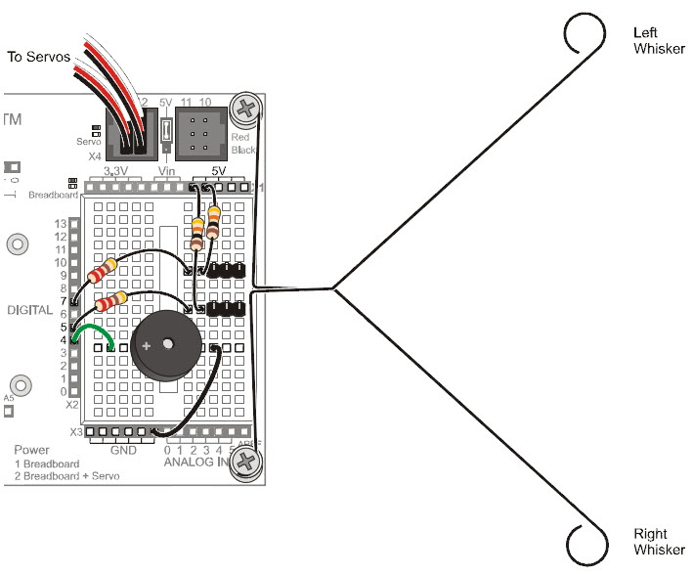
Sensors

Slide 36
Serial Monitor
void setup(){
Serial.begin(9600);
}
void loop(){
Serial.println(“Print a line”);
}

Slide 37
Serial Monitor
void setup(){
pinMode(5 , INPUT);
}
void loop(){
byte wLeft = digitalRead(5);
if(wLeft == 0)
{
backward(1000);
}
}

Slide 38
Create a robot that will escape a corner
In groups with the rest of your table - 40 min:
Create a robot that can tell when it is in a corner and escape it.

Slide 39
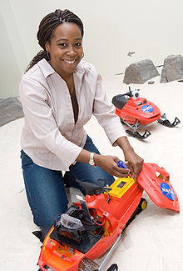
WOMAN IN TECH SPOTLIGHT: Ayanna Howard
Professor at Georgia Tech in Electrical Engineering and Robotics
Builds Tech to help people with disabilities
Used to work at JPL helping robots navigate landing on Mars

Slide 40
WOMAN IN TECH SPOTLIGHT: Ayanna Howard
1 minute:
Research Ayanna Howard
Find an interesting fact.
Why did Ayanna Howard choose to study robotics?
What does she like about her job?
Why are the robots Ayanna Howard creates useful?

Slide 41
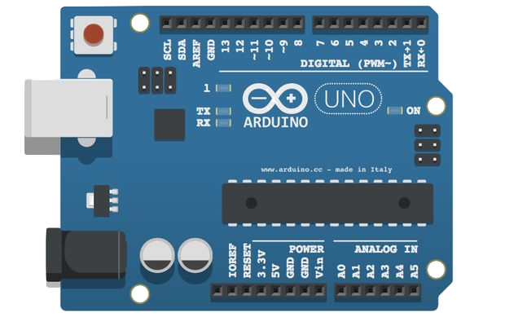
What is an Arduino?
Differentiation
Digital Input/Output (or I/O) pins
Microcontroller “Brain”
Notes:
Animation step 1:
An arduino is a microcontroller that allows you to connect and control electrical circuits to your computer.
Animation step 2:
The pins of the arduino is where you connect the different elec

Slide 42
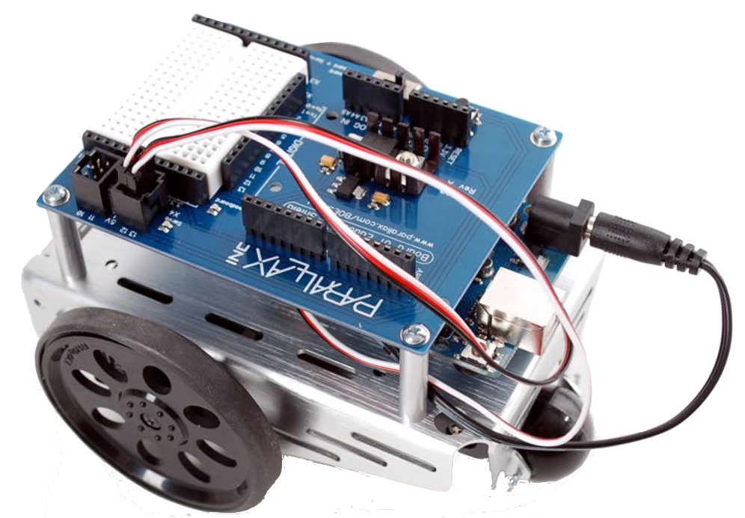
What is the BoE Shield?
Breadboard
Arduino
Servo Ports
Front
Back
Notes:
The Parallax Board of Education robot (or BoE bot) adds additional capability to an arduino. The board lets the user create circuits to interact with the arduino and adds more motor controlling functionality (for the wheels). The rest acts as the robot body.
Today and tomorrow we will focus on how the breadboard interacts with the arduino. Wednesday we will get to making the robot move around.

Slide 43
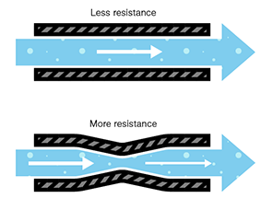
What are resistors?
We need resistors so the circuit doesn’t catch on fire!

Slide 44
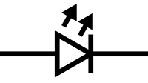
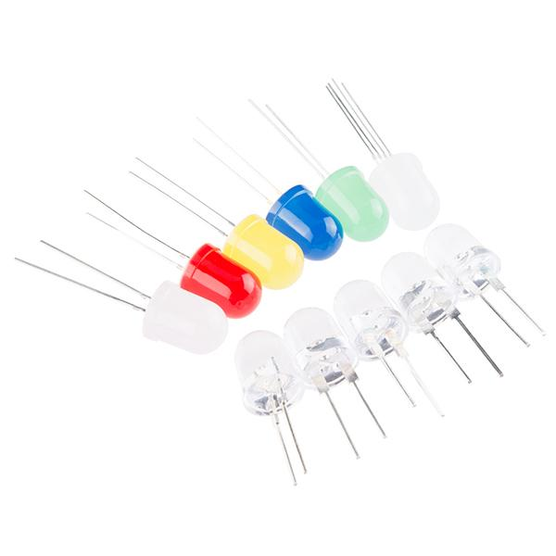
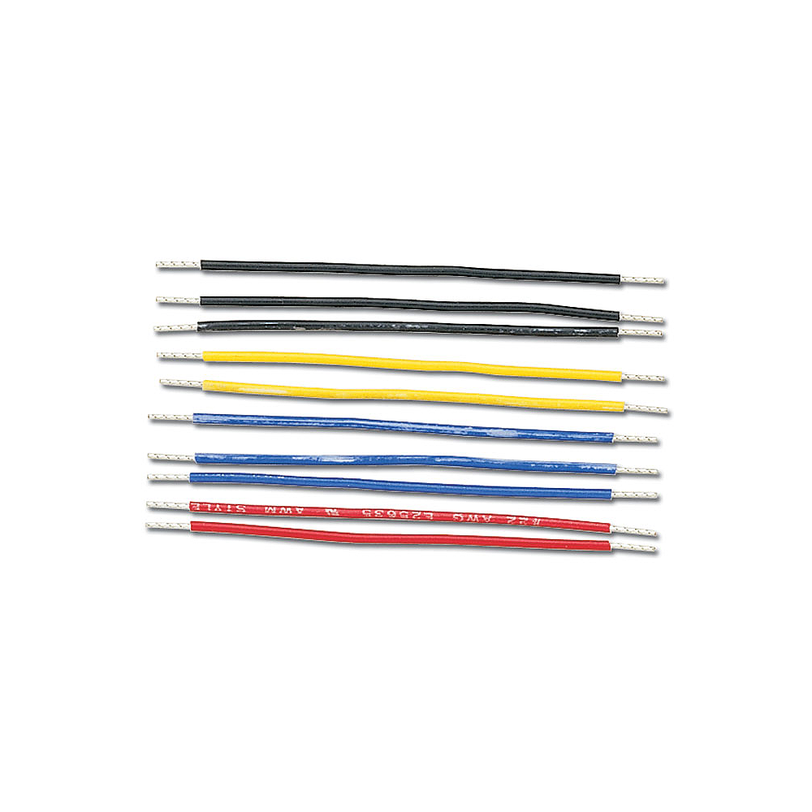
Circuit Component Scavenger Hunt
LEDs
Light up
Jump Wires
Move electricity
Notes:
The Parallax Board of Education robot (or BoE bot) adds additional capability to an arduino. The board lets the user create circuits to interact with the arduino and adds more motor controlling functionality (for the wheels). The rest acts as the robot body.
Today and tomorrow we will focus on how the breadboard interacts with the arduino. Wednesday we will get to making the robot move around.

Slide 45
What is an Arduino?
Digital Input/Output (or I/O) pins
Microcontroller “Brain”
Notes:
Animation step 1:
An arduino is a microcontroller that allows you to connect and control electrical circuits to your computer.
Animation step 2:
The pins of the arduino is where you connect the different elec

Slide 46
Servos
Jigsaw Protocol
3 min - individually or in groups
Split into these readings by table:
"What is a Servo?" - Article describing how servo motors work.
Parallax Reference Book - Chapter on Servo Motors.
Answer the questions associated with your reading. We’ll summarize for the group

